Slide 1

National Home Delivery Association
Business Email Compromise:
Preparation, Response and Preventative Measures
Mark A. Sadler, JD, CIPP/US, Divisional Vice President, Great American Insurance Group, 513.412.9233 | msadler@gaig.com
Mary T. Costigan, CIPP/US, Of Counsel, Jackson Lewis, P.C. 908.795.5135| mary.costigan@jacksonlewis.com

Slide 2
The materials in this presentation are for the general information of attendees. The materials or discussions about the materials are not advice, legal or otherwise, regarding any specific matter.

Slide 3
Business Email Compromise – Defining the Threat
What is a Business Email Compromise?
  a criminal act whereby cyber criminals gain access to a business email account, and masquerading as the account owner, issue emails to unsuspecting victims that appear to be legitimate.
The attacks are less technically complex and often involve phishing and other engineering techniques as opposed to the complex attack vectors often used in ransomware attacks.

Slide 4
BEC by the Numbers - A Serious and Increasing Crime
According to the FBI Internet Crime Complain Center (“IC3”):
Between July of 2019 and December of 2021 there was a sixty five percent increase in business email compromise and email account compromise attacks targeting small local businesses and large corporations.
Between June of 2016 and December 2021; the domestic and international dollar loss resulting from these incidents was $43,312,749,946.
During 2022, IC3 received twenty on thousand eight hundred thirty-two complaints involving business email compromise representing adjusted losses over $2.7 billion dollars.

Slide 5
Common BEC Attacks – Fraud Scenarios
ACH Transfer and Fraudulent Invoice Schemes
CEO Fraud
Account Compromise
Attorney Impersonation
Data Theft

Slide 6

What’s at Risk?
Company or customer funds
Employee PII
Company proprietary information (IP, customer lists, business arrangements, financials)
Customer financial information
Business relationships
Reputation

Slide 7
Warning Signs
Urgent Request
Different Domain
Sender is Out of Contact
Sent to Multiple Emails/Multiple recipients
Incorrect Context
Secrecy
Spelling and grammatical errors: expect this to change with AI
Jackson Lewis P.C.

Slide 8

Response
Initiate Incident Response Plan
Contain and Remediate
Notify relevant parties/financial institutions
Investigate
Identify notification obligations
Review and identify lessons learned
Jackson Lewis P.C.

Slide 9

Incident Response Plan: who does what, when and how
Notify -
predetermined team members; contact information, responsibilities
Notify -
financial institution(s); contact information, reporting requirements
Notify -
insurance carrier; contact information, reporting requirements
Notify -
law enforcement; contact information, reporting requirements
Engage -
cybersecurity forensic investigation team; preserve evidence
Engage -
external counsel; directs investigation, reviews reporting obligations
Notify -
affected individuals; relevant external organizations; regulators
Jackson Lewis P.C.

Slide 10

Containment and Remediation
Lockdown email systems.
Ensure passwords and credentials for all impacted accounts have been rest.
Update passwords for all apps.
Freeze transfer of funds.
Disable any email rules written by bad actors.
1
Monitor for ongoing malicious activity.
Block the domains of any third party identified during the investigation to prevent receiving their email.
Ensure no backdoors.
Preserve evidence: extract and preserve all relevant logs and artifacts.
2
Run virus scan to ensure devices aren’t compromised.
Implement tools for detection and response; anomalous login activity from unusual geographical locations.
3
Jackson Lewis P.C.

Slide 11
Investigation
unauthorized access (email accounts, OneDrive, SharePoint)
search terms used by bad actors
mailbox rules created by bad actors
lateral movement into systems
method of compromise
whether mailbox synced or downloaded
unauthorized emails sent externally by the threat actor
length of time in email account
data mine
Jackson Lewis P.C.

Slide 12

Assessment of Potential Reporting Obligations
Legal or regulatory
State or federal data breach notification laws
Contractual
Business partners
Financial institutions
Vendors
Federal contractor
Jackson Lewis P.C.

Slide 13
Preventative Measures
Review and update email retention policies to limit excessive retention.
Create regular backup of email server.
Create policies prohibiting employees from emailing or receiving sensitive or personal identifiable information unless required for role.
Ensure logging activity and changes is enabled and adequate (minimum 90 days – check your license).
Adhere to need to know based role access to sensitive data.
Review remote work access practices for vulnerabilities.
Require authentication of all financial transactions through two-factor authentication (i.e., bank log in credentials as well as transfers).
Confirm all payment method changes.
Review with your financial institutions the controls in place to minimize risk; emergency contacts.

Slide 14

Store logging data in a secure location (e.g., a secondary system)
Review your cyber insurance coverage; review and update incident response plan
Review the company’s social media/Internet presence
Provide ongoing employee security awareness training (phishing, vishing, and smishing); use phishing simulations for employees
Create layered payment protocols, call back requirements
Perform regular risk assessments for email and cloud security
Include a banner on emails, invoices, etc. stating the company won’t change it’s ACH or bank account number through an email

Slide 15

Implement tools to detect, monitor, alert and block
  Enable security features to block suspicious emails
  Remove legacy email protocols such as POP, IMAP, SMTP (these can be used to circumvent MFA and can be easily hacked)
  Disable external email forwarding
  Use encryption at rest, secure transfer tools
  Create rules that flag emails from unknown domains
  Monitor and/or restrict the creation of new email rules in the email server environment
  Create email filtering policies
  Use multifactor authentication; password protected files
NOTE: typical system controls such as firewalls and anti-virus software will not prevent a BEC

Slide 16
Questions For Your Team
What sensitive information is in company email accounts, OneDrive, SharePoint?
Does the company have a layered payment protocol?
Does the company conduct ongoing employee security awareness training?
Does the company have a data retention schedule for email accounts?
Does the company have extended logs retention?
Does the company have an Incident Response Plan that includes BEC attacks?

Slide 17


Slide 18

Resources
https://www.secretservice.gov/investigation/Preparing-for-a-Cyber-Incident/BECInfosec
Field Offices | United States Secret Service (report to the US Secret Service)
https://www.fbi.gov/how-we-can-help-you/safety-resources/scams-and-safety/common-scams-and-crimes/business-email-compromise
https://www.ic3.gov/Home/ComplaintChoice (report to the FBI)

Slide 19
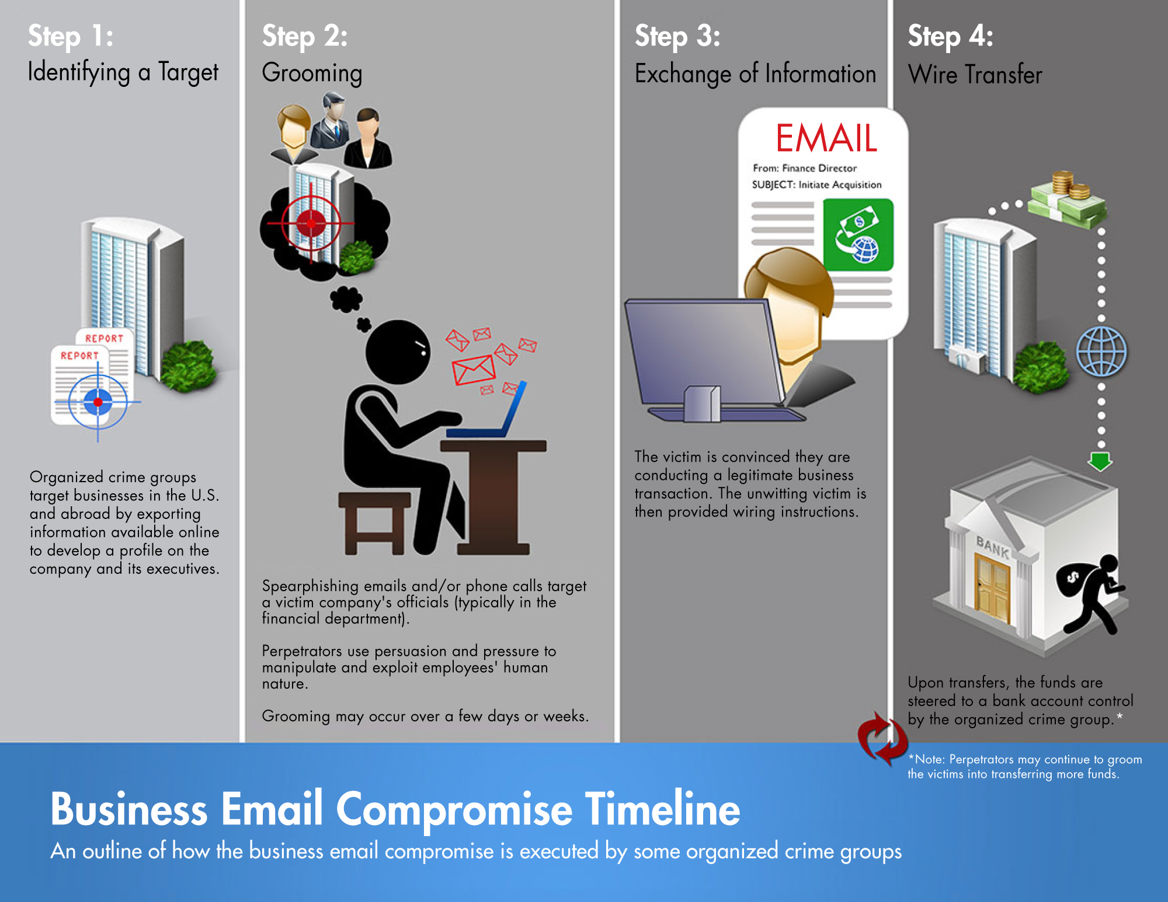
https://www.fbi.gov/how-we-can-help-you/safety-resources/scams-and-safety/common-scams-and-crimes/business-email-compromise

Slide 20
Thank you.

